Slide 1


API Automation
Day 1 - Introduction to Postman & RestAssured

Slide 2
Prerequisite
Java should be installed on system.
Eclipse / Itellijidea IDE should be installed.
Postman should be installed.

Slide 3
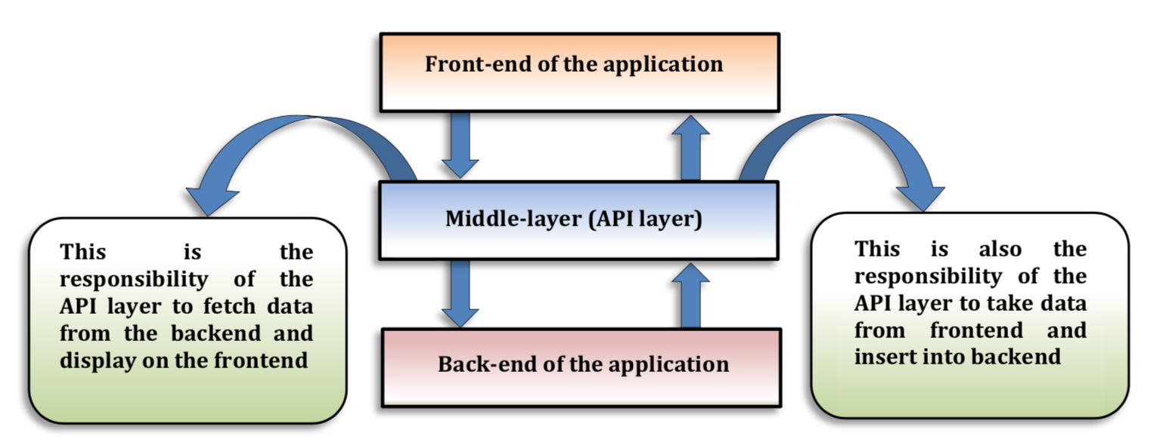
What is API?
Application Programming Interface(API) :-
A software interface that allows two applications to interact with each other without any user intervention.
API is a collection of software functions and procedures. In simple terms, API means a software code that can be accessed or executed. API is defined as a code that helps two different software's to communicate and exchange data with each other.
Notes:
Poll No:1

Slide 4
Introduction to Web Services
What is Web Service?
Is a standardized medium to propagate communication between the client and server applications on the World Wide Web. A web service is a software module that is designed to perform a certain set of tasks.
Types of Web Services:-
RestFul Web Services
SOAP Web Services

Slide 5
SOAP VS REST Web Services
SOAP | REST
SOAP is a protocol. | REST is an architectural style.
SOAP stands for Simple Object Access Protocol | REST stands for REpresentational State Transfer.
SOAP uses services interfaces to expose the business logic. | REST uses URI to expose business logic.
SOAP permits XML data format only. | REST permits different data format such as Plain text, HTML, XML, JSON etc.
JAX-WS is the java API for SOAP web services. | JAX-RS is the java API for RESTful web services.
SOAP requires more bandwidth and resource than REST. | REST requires less bandwidth and resource than SOAP.

Slide 6



Usage of REST Web Services
Mobile Application
Web Application
Internet of Things(IOT)

Slide 7
API Testing
What is API testing?
Where is API testing performed?
Benefits of API testing?
Notes:
Poll No:2 & 3

Slide 8
API Testing Types
Validation Testing
Functional Testing
Load Testing
Security Testing
Runtime/Error Detection
Penetration Testing
Notes:
Poll No:2 & 3

Slide 9
Why API Automation?
Test core for core functionality
Time effective
Business logic often exposed at API level
Tests are much more stable than UI-driven tests
To narrow down the probabilities of defect detection at later stages
Overall cost reduction of testing
Access to the application with user- interface
Notes:
Poll No:2 & 3

Slide 10

Postman
Manual Testing with Postman
Automation Testing with Postman
Collections
Environments in Postman
Newman Runner
Notes:
Poll No:2 & 3

Slide 11
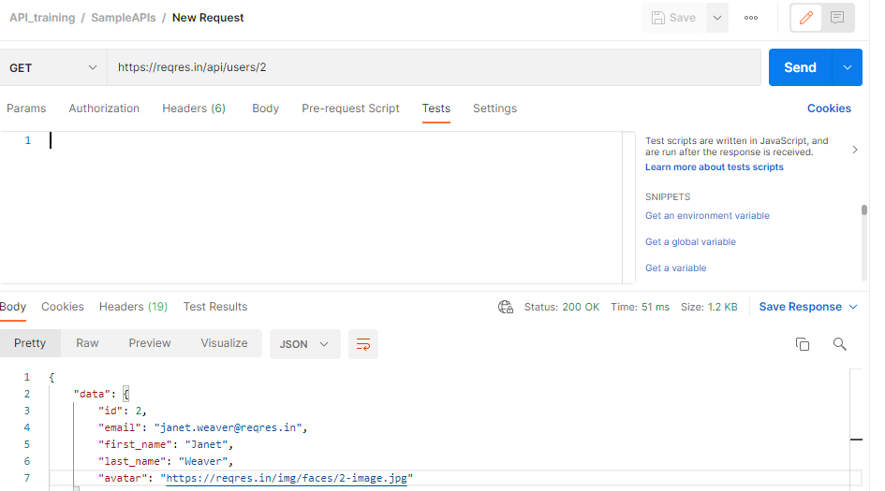
Sample Request in Postman and Automation Process
Notes:
Poll No:2 & 3

Slide 12
What is RestAssured
RESTAssured is a Java-based library which behaves like a headless Client to access REST web services.
It runs on the top of unit testing frameworks like TestNG, JUnit.
It removes lots of boilerplate (Repeated) code.
REST Assured is Open source which is developed and maintained by Johan Haleby.
Official site - https://rest-assured.io/

Slide 13
What is RestAssured
Maven - Add below dependency in the Pom.xml file
<dependency>
<groupId>io.rest-assured</groupId>
<artifactId>rest-assured</artifactId>
<version>4.3.3</version>
<scope>test</scope>
</dependency>
Gradle - Add below dependency in Gradle file
testImplementation 'io.rest-assured:json-path:4.3.3'
Non Maven Users -
Download from https://rest-assured.io/ and put it in your project.

Slide 14
Support all HTTP Methods
Get | it is used to fetch the data from the given resource location.
Post | Data is required for this kind of request. It is used to insert the data at the given resource location.
Put | Data is required for this request. Whole of the data is passed that is to be updated and the one that is not to be updated. Requires certain ID value too to update that particular record. Success code - 200 or 204.
Patch | Data is required to for this http request also. Only that data is passed which is required to be updated, Requires certain ID value too to update that particular record. Success code - 204
Delete | No data is required to this request. It deletes the record (data) from the given resource location. Requires certain ID value too to update that articular record.Success code - 200 or 204.
Notes:
Poll : 4 & 5

Slide 15
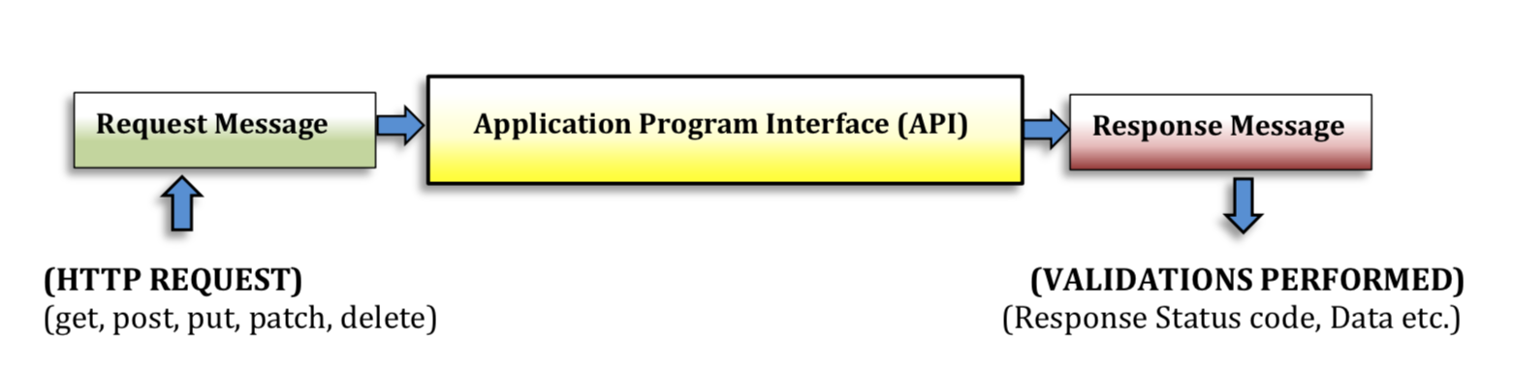
Basics of API Automation
We will be performing following steps in API Automation:
We require request body for the http requests so, we will be creating body data with various techniques.
Sending various http requests and so will get some response so, we will be validating the response like status code.
Validating response data as well.

Slide 16
Support Gherkin Syntax
For writing REST Assured it supports Gherkin Syntax to write test case in BDD format:
1. Given() Prerequisite/Pre-condition section: This section starts with given() method of RestAssured class and returns the object of RequestSpecification class. Generally, we write all the pre-conditions like contentType, body etc. in this section before hitting the request.
2. When() Http Method: This section starts with the .when() method of RequestSpecification class and it returns the object of RequestSpecification class. It contains the http request method that we want to hit like get(), post(), put(), patch() and delete().
3. Then() The Ending section: This section starts with the .then() method. This is the last section and we write all the validations that we want to do after the request is hit. For an instance to check whether the http request we hit in the 2nd section was success or not. We check the status of that particular hit request which are predefined

Slide 17
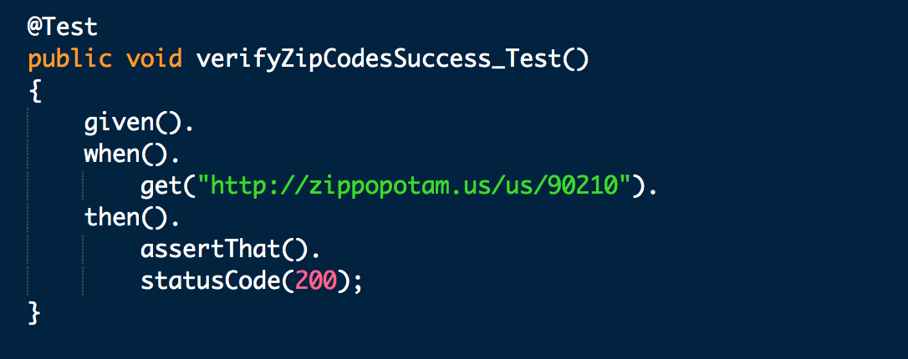
Support Gherkin Syntax sample

Slide 18


